Slide 1
Fuzzy Identity-Based Data Integrity Auditing for Reliable Cloud Storage Systems

Slide 2
ABSTRACT
In this paper, we seek to address the complex key management challenge in cloud data integrity checking by introducing fuzzy identity-based auditing, the first in such an approach, to the best of our knowledge. More specifically, we present the primitive of fuzzy identity-based data auditing, where a user’s identity can be viewed as a set of descriptive attributes. We formalize the system model and the security model for this new primitive.

Slide 3
EXISTING SYSTEM
Deswarte et al. proposed the concept of remote data integrity checking (RDIC, is also known as data integrity auditing), which comprises three parties, namely: cloud server, data owner and third party auditor (TPA). A publicly verifiable RDIC protocol allows the TPA or anyone to check the integrity of the stored data on the cloud without the need to retrieve the entire dataset.

Slide 4
DISADVANTAGES OF EXISTING SYSTEM
Firstly, generation, management and revocation of certificates is complex and computationally expensive, and consequently scalability is challenging.
Secondly, the level of trust required of CA may be unrealistic, particularly in light of recent high profile incidents.

Slide 5
PROPOSED SYSTEM
In this paper, we seek to simplify key management issue of remote data integrity auditing protocols by introducing biometric-based identities in traditional RDIC protocols. We regard our contributions to be three-fold.
We propose the notion of fuzzy identity-based data integrity auditing designed to simplify key management.

Slide 6
We then formalize the system model and security model to ensure the security called soundness of this new primitive (i.e. if a cloud server can convince a verifier that the server is storing a file, if and only if it is actually storing that file).
We describe a concrete construction of fuzzy identity-based data integrity auditing protocol, by borrowing the idea of fuzzy identity-based encryption due to Shacham and Waters.

Slide 7
ADVANTAGES OF PROPOSED SYSTEM
We prove that the biometric-based data integrity auditing protocol achieves the property of soundness.
Even if a cloud server exhibits arbitrary dishonest behavior, the server must store the file with a high probability provided that it generates a valid response for a challenge of the file.

Slide 8
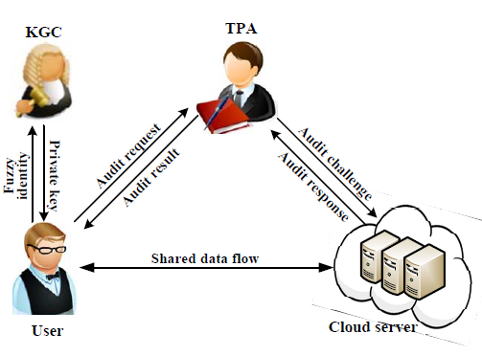
SYSTEM ARCHITECTURE

Slide 9
HARDWARE REQUIREMENTS
System : Pentium i3 Processor
Hard Disk : 500 GB.
Monitor : 15’’ LED
Input Devices : Keyboard, Mouse
Ram : 2 GB

Slide 10
SOFTWARE REQUIREMENTS
Operating system : Windows 10.
Coding Language : JAVA.
Tool : Netbeans 8.2
Database : MYSQL

Slide 11
REFERENCE
Yannan Li, Yong Yu_, Geyong Min, Willy Susilo, Jianbing Ni and Kim-Kwang Raymond Choo, “Fuzzy Identity-Based Data Integrity Auditing for Reliable Cloud Storage Systems”, IEEE Transactions on Dependable and Secure Computing, Volume: 16 , Issue: 1 , Jan.-Feb. 1 2019.

